Slide 1
The OSI Model and
the TCP/IP Protocol Suite
Established in 1947, the International Standards Organization (ISO) is a multinational body dedicated to worldwide agreement on international standards. An ISO standard that covers all aspects of network communications is the Open Systems Interconnection (OSI) model. It was first introduced in the late 1970s.

Slide 2
The OSI Model
An ISO (International standard Organization) that covers all aspects of network communications is the Open System Interconnection (OSI) model.
An open system is a model that allows any two different systems to communicate regardless of their underlying architecture (hardware or software).
The OSI model is not a protocol; it is model for understanding and designing a network architecture that is flexible, robust and interoperable.

Slide 3
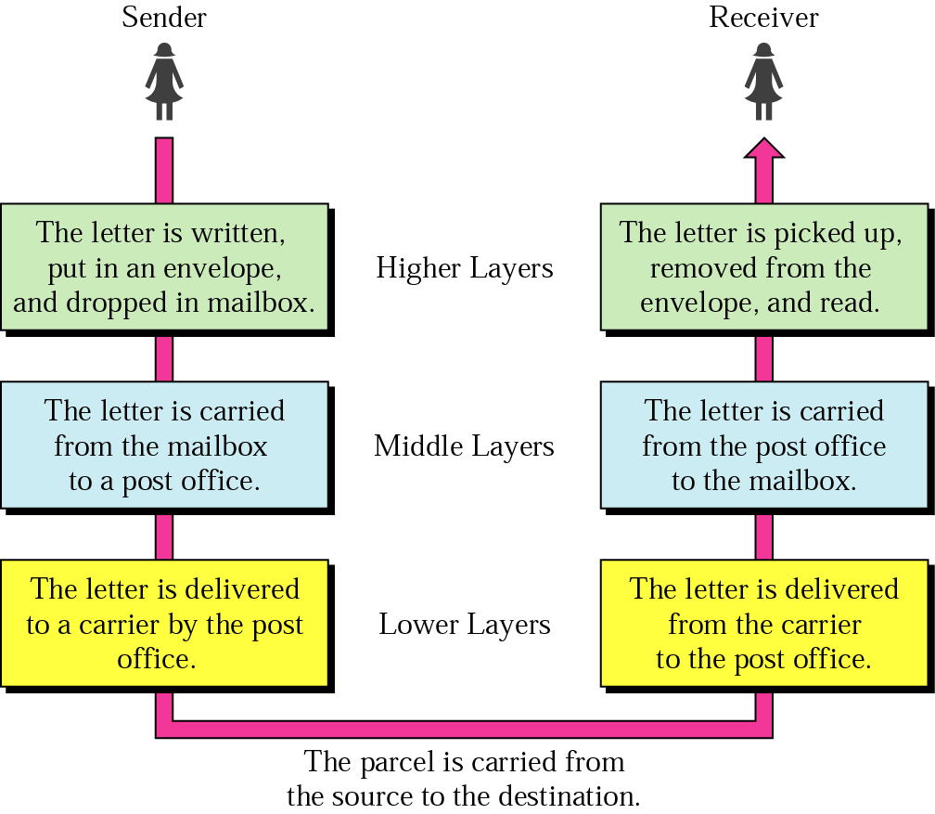
Figure 2.1 Sending a letter

Slide 4
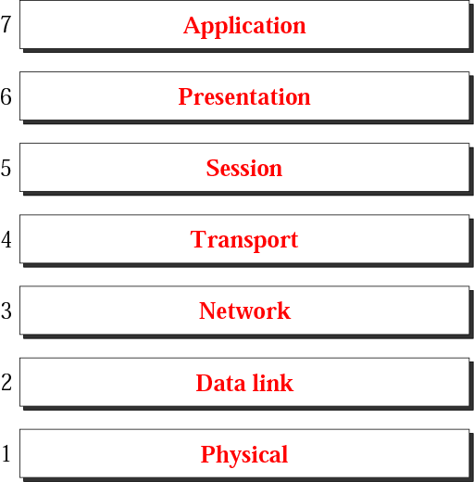
Figure 2.1 The OSI model

Slide 5
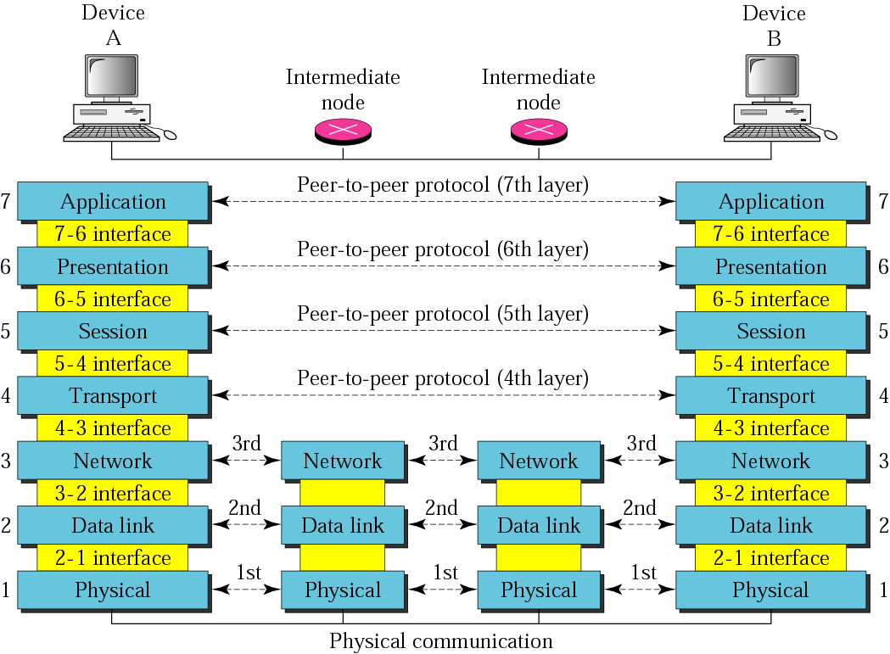
Figure 2.2 OSI layers

Slide 6
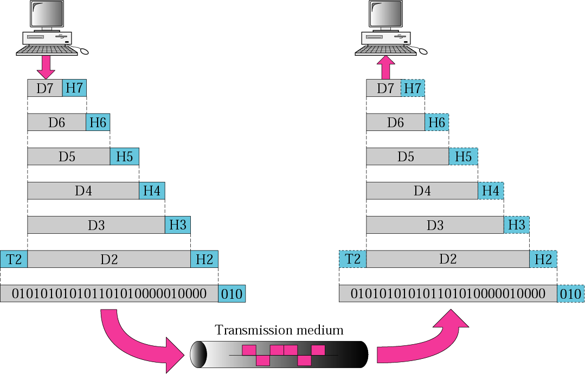
Figure 2.3 An exchange using the OSI model

Slide 7
2.2 Layers in the OSI Model
The functions of each layer in the OSI model is briefly described.
The topics discussed in this section include:
Physical Layer
Data Link Layer
Network Layer
Transport Layer
Session Layer
Presentation Layer
Application Layer
Summary of Layers

Slide 8
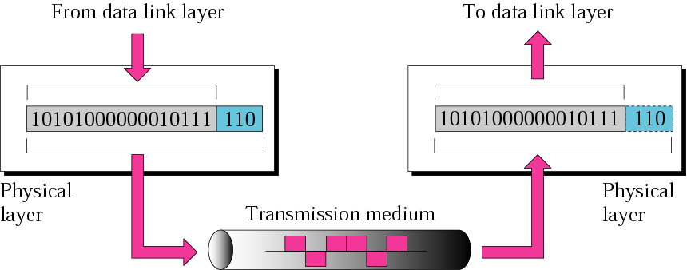
Figure 2.4 Physical layer

Slide 9
Physical layer
The physical layer is concerned with the following:
Physical characteristics of interfaces and media: The physical layer defines the characteristics of the interface between devices and the transmission media, including its type.
Representation of the bits: the physical layer data consist of a stream of bits without any interpretation. To be transmitted, bits must be encoded into signals –electrical or optical-. The physical layer defines the type of encoding.
Data rate: The physical layer defines the transmission rate, the number of bits sent each second.

Slide 10
Physical Layer
Line configuration: the physical layer is concerned with the connection of devices to the medium.
Physical topology
Transmission Mode

Slide 11
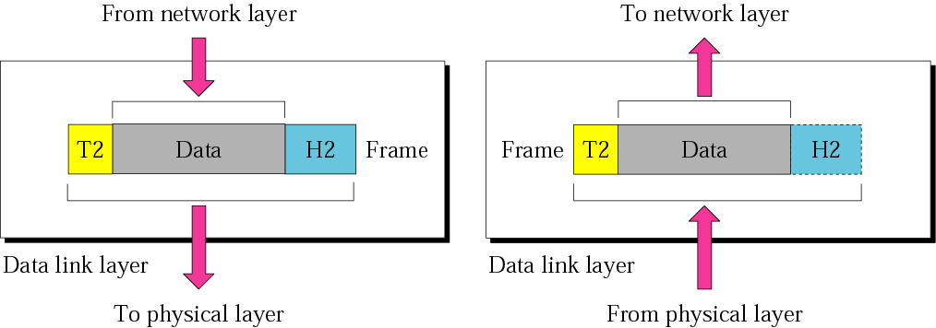
Figure 2.5 Data link layer

Slide 12
Functions of the data link layer:
Framing. The data link layer divides the stream of bits received from the network layer into data units called frames.
Physical addressing. If frames are to be distributed to different systems on the network, the data link layer adds a header to the frame to define the physical address of the sender (source address) and/or receiver (destination address) of the frame.
If the frame is intended for a system outside the sender’s network, the receiver address is the address of the device that connects one network to the next.

Slide 13
Flow Control. If the rate at which the data are absorbed by the receiver is less than the rate produced in the sender, the data link layer imposes a flow control mechanism to prevent overwhelming the receiver.
Error control. The data link layer adds reliability to the physical layer by adding mechanisms to detect and retransmit damaged or lost frames. Error control is normally achieved through a trailer to the end of the frame.
Access Control. When two or more devices are connected to the same link, data link layer protocols are necessary to determine which device has control over the link at any time.

Slide 14
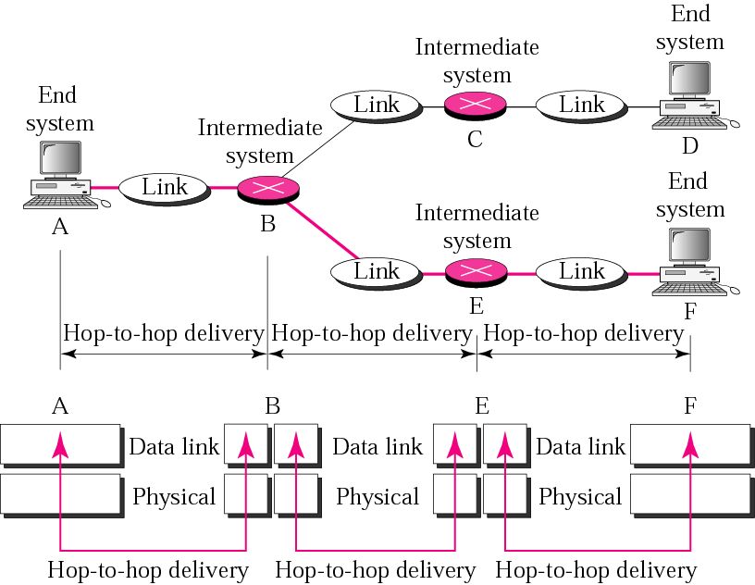
Figure 2.6 Hop-to-hop delivery

Slide 15
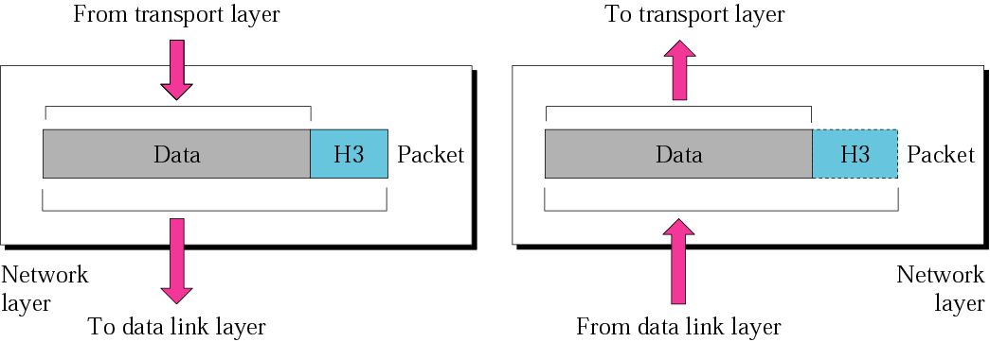
Figure 2.7 Network layer

Slide 16
Network Layer
The Network layer is responsible for the source-to-destination delivery of a packet possible across multiple networks.
If two systems are connected to the same link, there is usually no need for a network layer. However, if the two systems are attached to different networks, there is often a need for the network layer to accomplish source-to-destination delivery.

Slide 17
Logical addressing. The physical addressing implemented by the data link layer handles the addressing problem locally.
The network layer adds a header to the packet coming from the upper layer, among other things, includes the logical address of the sender and receiver.
Routing. When independent networks or links are connected together to create an internetwork (a network of networks) or a large network, the connecting devices (called routers or gateways) route or switch the packets to their final destination.

Slide 18
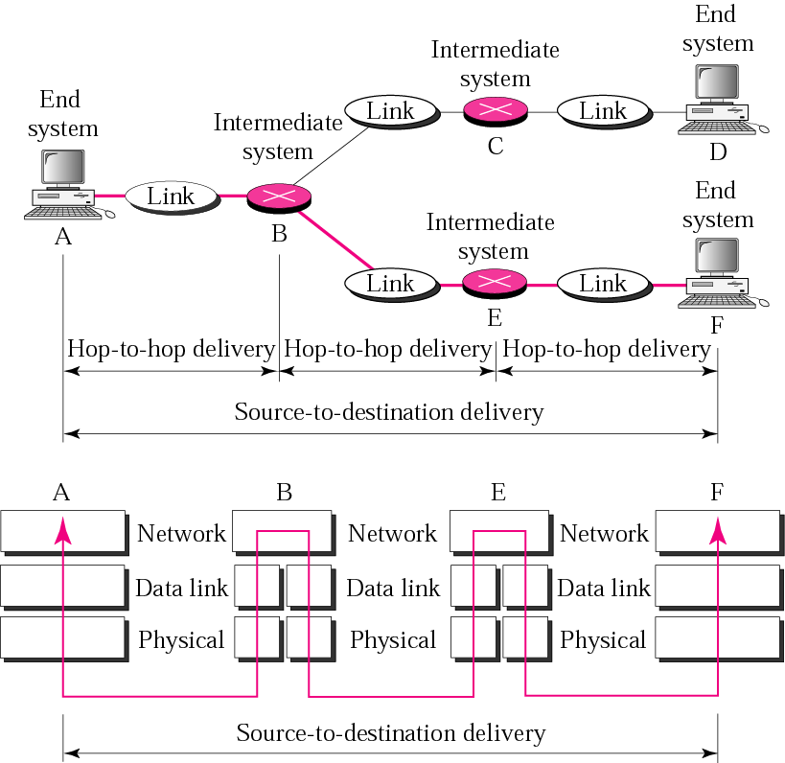
Figure 2.8 Source-to-destination delivery

Slide 19
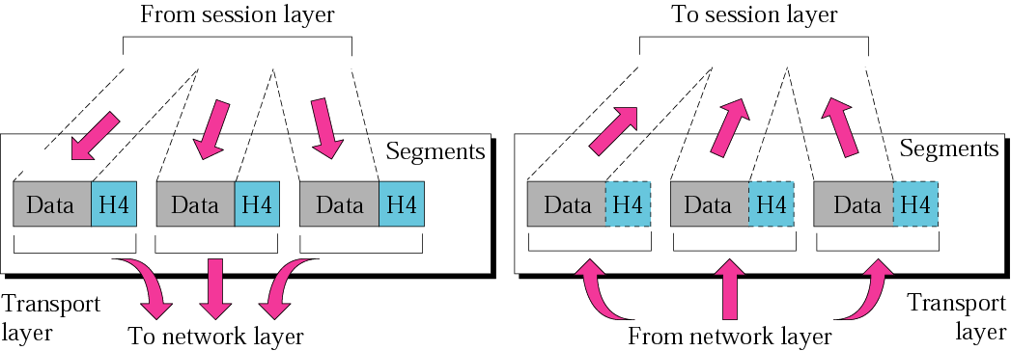
Figure 2.9 Transport layer

Slide 20
Transport Layer
The transport layer is responsible for process-to-process delivery of the entire message.
The network layer oversees host-to-destination delivery of individual packets, it does not recognize any relationship between those packets.
The transport layer ensures that the whole message arrives intact and in order, overseeing both error control and flow control at the process-to-process level.

Slide 21
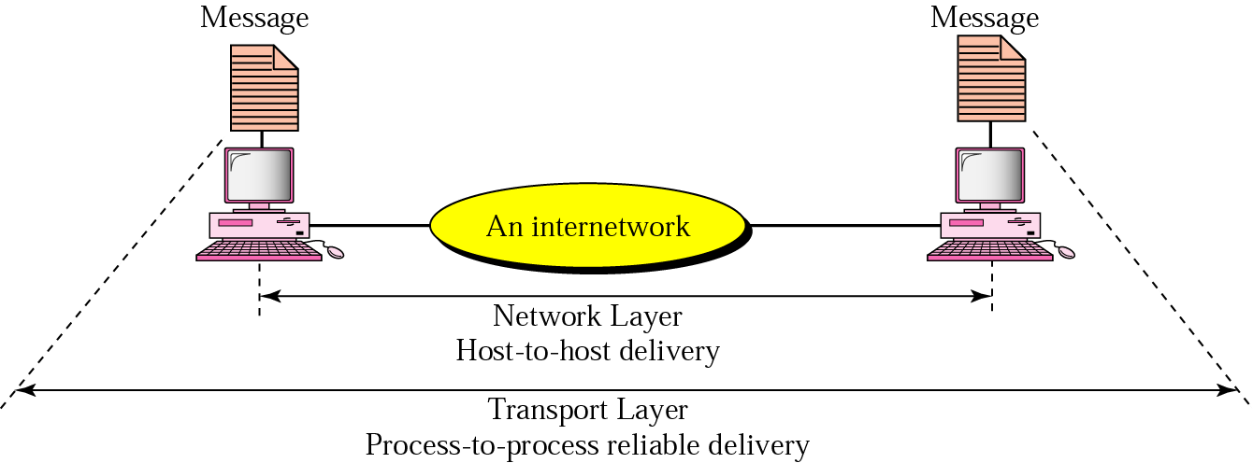
Reliable process-to-process delivery of a message

Slide 22
Functions of the transport layer
Port addressing:computer often run several processes (running programs) at the same time. Process-to-process delivery means delivery from a specific process on one computer to a specific process on the other.
The transport layer header include a type of address called port address.
The network layer gets each packet to the correct computer; the transport layer gets the entire message to the correct process on that computer.

Slide 23
Functions of the transport layer
Segmentation and reassembly: a message is divided into transmittable segments, each having a sequence number. These numbers enable the transport layer to reassemble the message correctly upon arrival at the destination.
Connection control: The transport layer can be either connectionless or connection-oriented.
A connectionless transport layer treats each segment as an independent packet and delivers it to the transport layer at the destination machine.
A connection-oriented transport layer makes a connection with the transport layer at the destination machine first before delivering the packets. After all the data are transferred, the connection is terminated.

Slide 24
Functions of the transport layer
Flow control: the transport layer performs a flow control end to end. The data link layer performs flow control across a single link.
Error control: the transport layer performs error control end to end. The data link layer performs control across a single link.

Slide 25
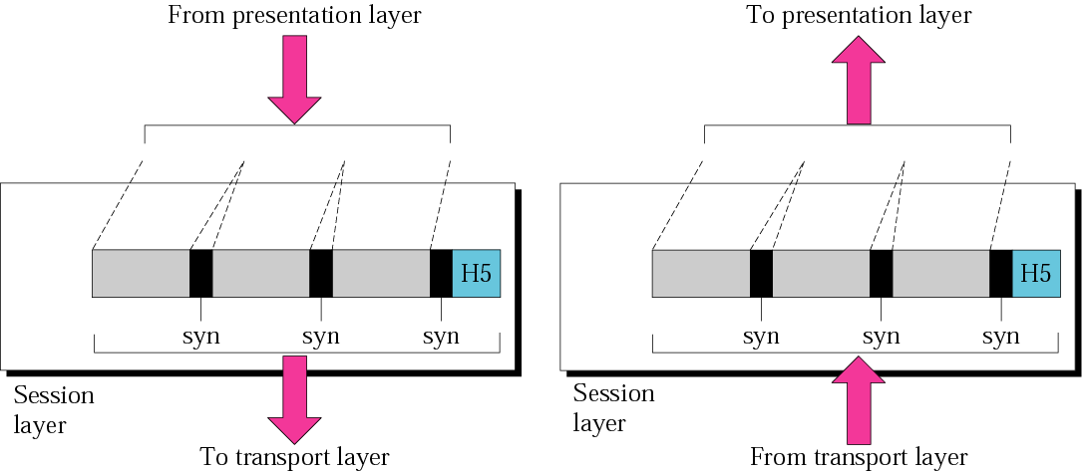
Figure 2.11 Session layer

Slide 26

Session Layer
OSI Model
Session layer provides mechanism for controlling the dialogue between the two end systems. It defines how to start, control and end conversations (called sessions) between applications.
This layer requests for a logical connection to be established on an end-user’s request.
Any necessary log-on or password validation is also handled by this layer.
Session layer is also responsible for terminating the connection.
This layer provides services like dialogue discipline which can be full duplex or half duplex.
Session layer can also provide check-pointing mechanism such that if a failure of some sort occurs between checkpoints, all data can be retransmitted from the last checkpoint.

Slide 27
SESSION LAYER
The session layer allows session establishment between processes running on different stations. It provides:
  Session establishment, maintenance and termination: allows two application processes on different machines to establish, use and terminate a connection, called a session.
  Session support: performs the functions that allow these processes to communicate over the network, performing security, name recognition, logging, and so on.

Slide 28
Session Layer
OSI Model

Slide 29

Session layer
Receiver
Sender

Slide 30
The session layer is responsible for dialog
control and synchronization.

Slide 31
LAYER 5: SESSION
The session layer defines how to start, control and end conversations (called sessions) between applications.
This includes the control and management of multiple bi-directional messages using dialogue control.
It also synchronizes dialogue between two hosts' presentation layers and manages their data exchange.
The session layer offers provisions for efficient data transfer.

Slide 32
Basic Functions for the Session Layer Protocols
Creating a connection – session/communication session between an APPLICATION in one computer and another APPLICATION in another computer
  THREE-WAY-HANDSHAKE: a method widely used to establish and end connection
    Sender sends SYN message to request a session to the receiver
    Receiver replies by sending ACK message to acknowledge the SYN message sent by the sender, and SYN message to request a session to the sender
    Sender replies by sending ACK message to acknowledge the SYN message sent by the receiver

Slide 33
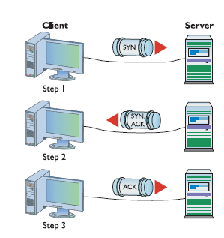
Basic Functions for the Session Layer Protocols

Slide 34
Basic Functions for the Session Layer Protocols
Managing multiple sessions
  A computer can establish multiple sessions with several other computers
    e.g., session 1: exchanging information over the World Wide Web with www.yahoo.com
    session 2: exchanging information over the World Wide Web with www.google.com
    session 3: exchanging information over the World Wide Web with www.espn.com
  Two computers can also establish multiple sessions,
    e.g., function 1: exchanging information over the World Wide Web;
    function 2: exchanging information over the FTP;
    function 3: exchanging information over the email

Slide 35
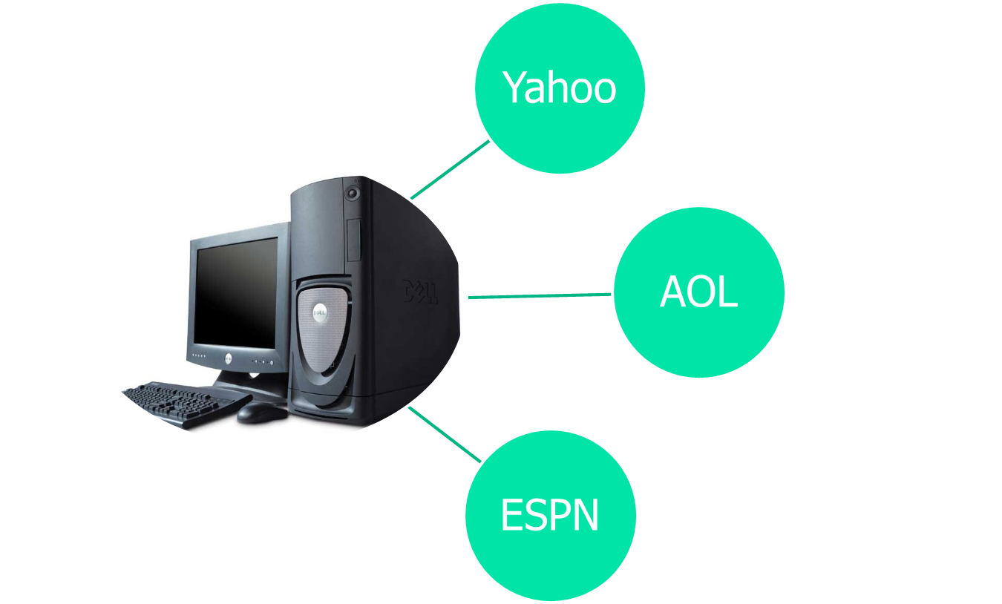
A computer can establish multiple sessions with several other computers

Slide 36


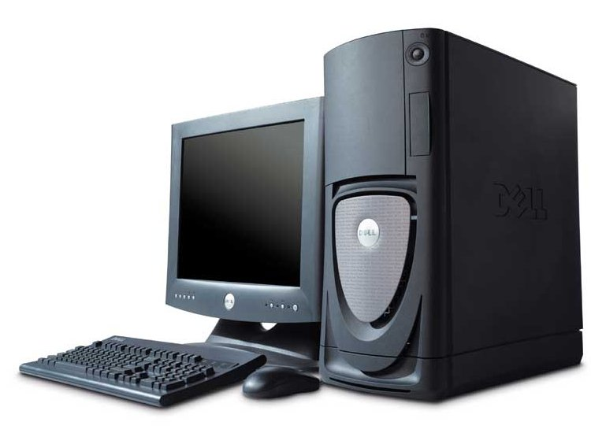
Two computers can establish multiple sessions
mail
music
news

Slide 37
Basic Functions for the Session Layer Protocols
Ending a session
  THREE-WAY-HANDSHAKE: a method widely used to establish and end connection
    Sender sends FIN message to close a session to the receiver
    Receiver replies by sending ACK message to acknowledge the FIN message sent by the sender, and FIN message to close a session to the sender
    Sender replies by sending ACK message to acknowledge the FIN message sent by the receiver

Slide 38
Session Layer protocols
ISO-SP: OSI Session Layer Protocol
PPTP, Point-to-Point Tunneling Protocol
RPC, Remote Procedure Call Protocol
RTCP, Real-time Transport Control Protocol
SQL is a Session layer application that manages multiple queries to the SQL database.

Slide 39
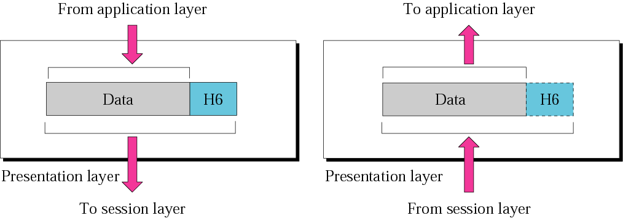
Figure 2.12 Presentation layer

Slide 40
PRESENTATION LAYER
The presentation layer formats the data to be presented to the application layer. It can be viewed as the translator for the network. This layer may translate data from a format used by the application layer into a common format at the sending station, then translate the common format to a format known to the application layer at the receiving station.
The presentation layer provides:
  Character code translation: for example, ASCII to EBCDIC (Extended Binary Coded Decimal Interchange Code).
  Data conversion: bit order, integer-floating point, and so on.
  Data compression: reduces the number of bits that need to be transmitted on the network.
  Data encryption: encrypt data for security purposes. For example, password encryption.

Slide 41
Presentation Layer

Slide 42

Presentation layer
2.<number>

Slide 43
The presentation layer is responsible for translation, compression, and encryption.
2.<number>

Slide 44
Presentation Layer
Translates data
Responsible for encrypting data
Manages data compression

Slide 45
Data translation
a sending computer receiving data from the application layer will need to convert data from the receiving format(eg ASCII) to a format understood and accepted by other layers of the OSI model to ensure smooth file transfer
the receiving computer is responsible for the conversion of “the external format” with which data is received from the sending computer to one accepted by the other layers in the host computer
Data formats include postscript, ASCII, or BINARY such as EBCDIC

Slide 46
Encryption
The process of transforming information (plaintext) using an algorithm (called cipher) to make it unreadable to anyone except those possessing special knowledge, usually referred to as a key.
The result of the process is encrypted information (referred to as ciphertext).

Slide 47
Compression
The goal of data compression is to represent an information source (a data file, an image) as accurately as possible using the fewest number of bits
For example, 25.888888888
  This string can be compressed as:
  25.[9]8
Interpreted as, "twenty five point 9 eights", the original string is perfectly recreated, just written in a smaller form

Slide 48
Presentation layer protocols
ASCII, American Standard Code for Information Interchange
EBCDIC, Extended Binary Coded Decimal Interchange Code
X.25 PAD, Packet Assembler/Disassembler Protocol

Slide 49
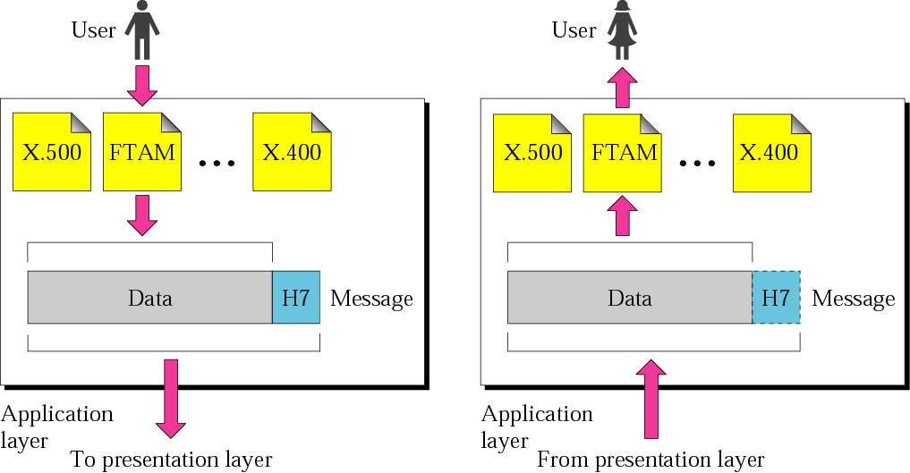
Figure 2.13 Application layer

Slide 50
Application Layer
OSI Model
Application layer interacts with application programs and is the highest level of OSI model.
Application layer contains management functions to support distributed applications.
Examples of application layer are applications such as file transfer, electronic mail, remote login etc.

Slide 51
APPLICATION LAYER
The application layer serves as the window for users and application processes to access network services. This layer contains a variety of commonly needed functions:
  Resource sharing and device redirection
  Remote file access
  Remote printer access
  Inter-process communication
  Network management
  Directory services
  Electronic messaging (such as mail)
  Network virtual terminals

Slide 52
Outline
Application Layer
  There is a need for support protocols, to allow the applications to function
Some network applications
  DNS: handles naming within the Internet
  POP – IMAP – SMTP: handle electronic mail
  FTP: File Transfer over the Internet
  WWW – HTTP: Web world
  Multimedia

Slide 53
Domain Name System - DNS
IP addresses can be used to identify a host machine on the Internet
  As those machines move around, the addresses need to be changed accordingly as well
ASCII names have been used to decouple host names and their IPs to provide more flexibility
The network itself still understands only numerical addresses
The DNS was invented to manage and resolve host names into IP addresses

Slide 54
DNS: Characteristics
A file host.txt listed all the hosts and their IP addresses, but issue some problems:
  File size, load and latency
  Host name conflict
Essence of DNS:
  Hierarchical
  Domain-based naming scheme
  A distributed database system

Slide 55
DNS: A Brief
To map a name onto an IP address, an application program:
  Calls a library procedure called the resolver, passing it the name as a parameter
  The resolver sends a UDP packet to a local DNS server
  DNS server looks up the name and returns the IP address to the resolver
  Resolver returns it to the application
  Armed with the IP address, the program can then establish a TCP connection with the destination or send it UDP packets

Slide 56
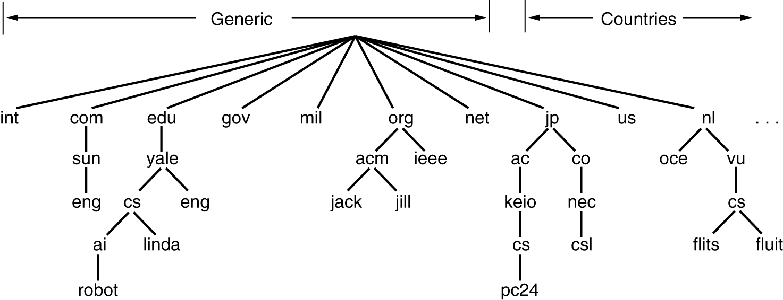

DNS Name Space
A portion of the Internet domain name space

Slide 57
DNS naming
Domain names are case insensitive: edu, Edu, EDU have the same meaning
Component name can be up to 63 characters
Full path names must not exceed 255 characters
Each domain name server manages its own name space. It can create subdomain names without asking for permission from upper server. Examples: hcmut.edu.vn and cse.hcmut.edu.vn

Slide 58
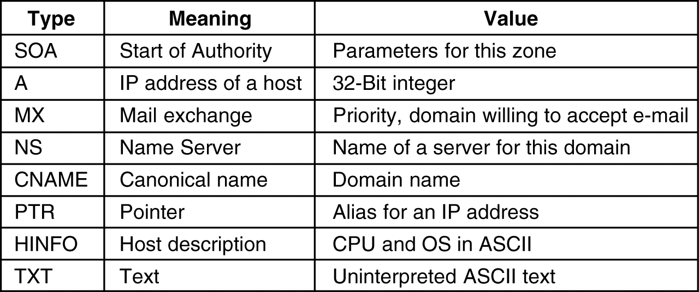
Resource Records
Every domain has a set of records associated with it
The principal DNS resource records types.

Slide 59
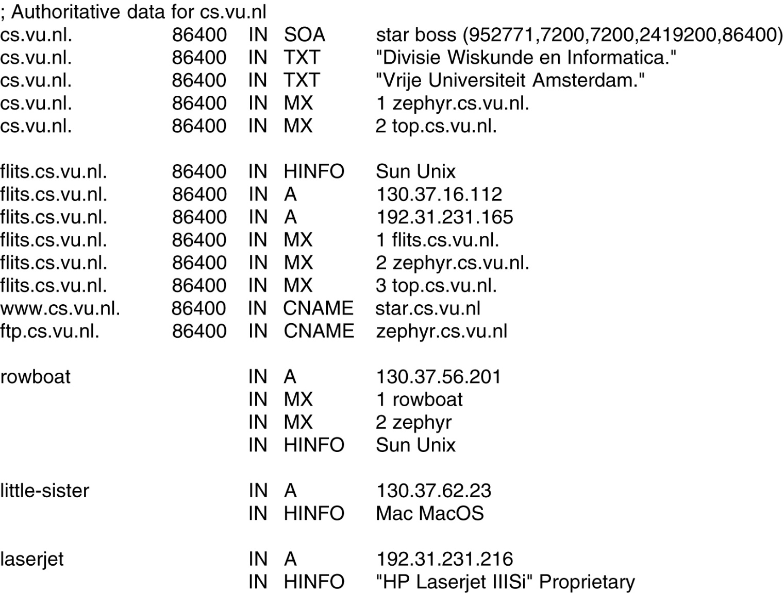
Resource Records (2)
A portion of a possible DNS database for cs.vu.nl.

Slide 60
Resource Records (3)
hcmut.edu.vn. IN SOA hcmut-server.hcmut.edu.vn. webmaster.hcmut.edu.vn. (
2004110800; serial
7200; refresh
3600; retry
604800; expire
86400 ); minimum
hcmut.edu.vn. 86400 IN NS vnuserv.vnuhcm.edu.vn.
hcmut.edu.vn. 86400 IN NS server.vnuhcm.edu.vn.
hcmut.edu.vn. 86400 IN MX 0 webmailserv.hcmut.edu.vn.
hcmut.edu.vn. 86400 IN MX 5 vnuserv.vnuhcm.edu.vn.
hcmut-server.hcmut.edu.vn. 86400 IN A 172.28.2.2
stu-mailserv.hcmut.edu.vn. 86400 IN A 172.28.2.3
webmailserv.hcmut.edu.vn. 86400 IN A 172.28.2.4
pop3.student.hcmut.edu.vn. 86400 IN CNAME stu-mailserv.hcmut.edu.vn.
www.student.hcmut.edu.vn 86400 IN CNAME stu-mailserv.hcmut.edu.vn.

Slide 61
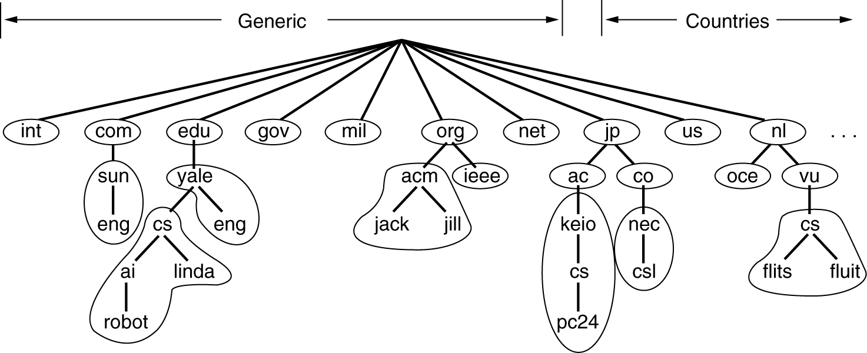
Name Servers
DNS Name Space is divided into non-overlapping zones
Each zone has Name Servers holding information about it

Slide 62

DNS - Query
root name server
2
iterated query
recursive query
  puts burden of name resolution on contacted name server.
  heavy load ?
iterated query
  contacted server replies with name of server to contact.
  “I don’t know this name, but ask this server”
3
4
7
local name server
dns.eurecom.fr
intermediate name server
dns.umass.edu
5
6
1
8
authoritative name server
dns.cs.umass.edu
requesting host
surf.eurecom.fr
gaia.cs.umass.edu

Slide 63
Electronic Mail – Email (or E-mail)
Has been around since the early days of Internet
Is widely used today
Informal form of communication
Simple and easy to use

Slide 64
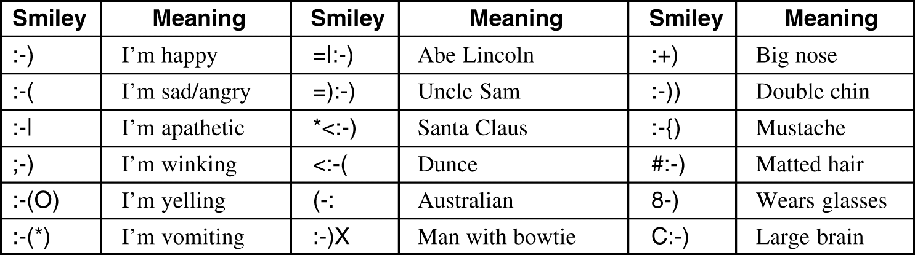
Electronic Mail (2)
Some smileys :-).

Slide 65
Architecture and Services
Basic email functions
Composition
Transfer
Reporting
Displaying
Disposition

Slide 66
Some email terms
mailbox – storage where incoming emails are saved for later processing
mailing list – a representative email address of a group of people. Email sent to this address will be forwarded to all of its participants
CC, BCC ...

Slide 67
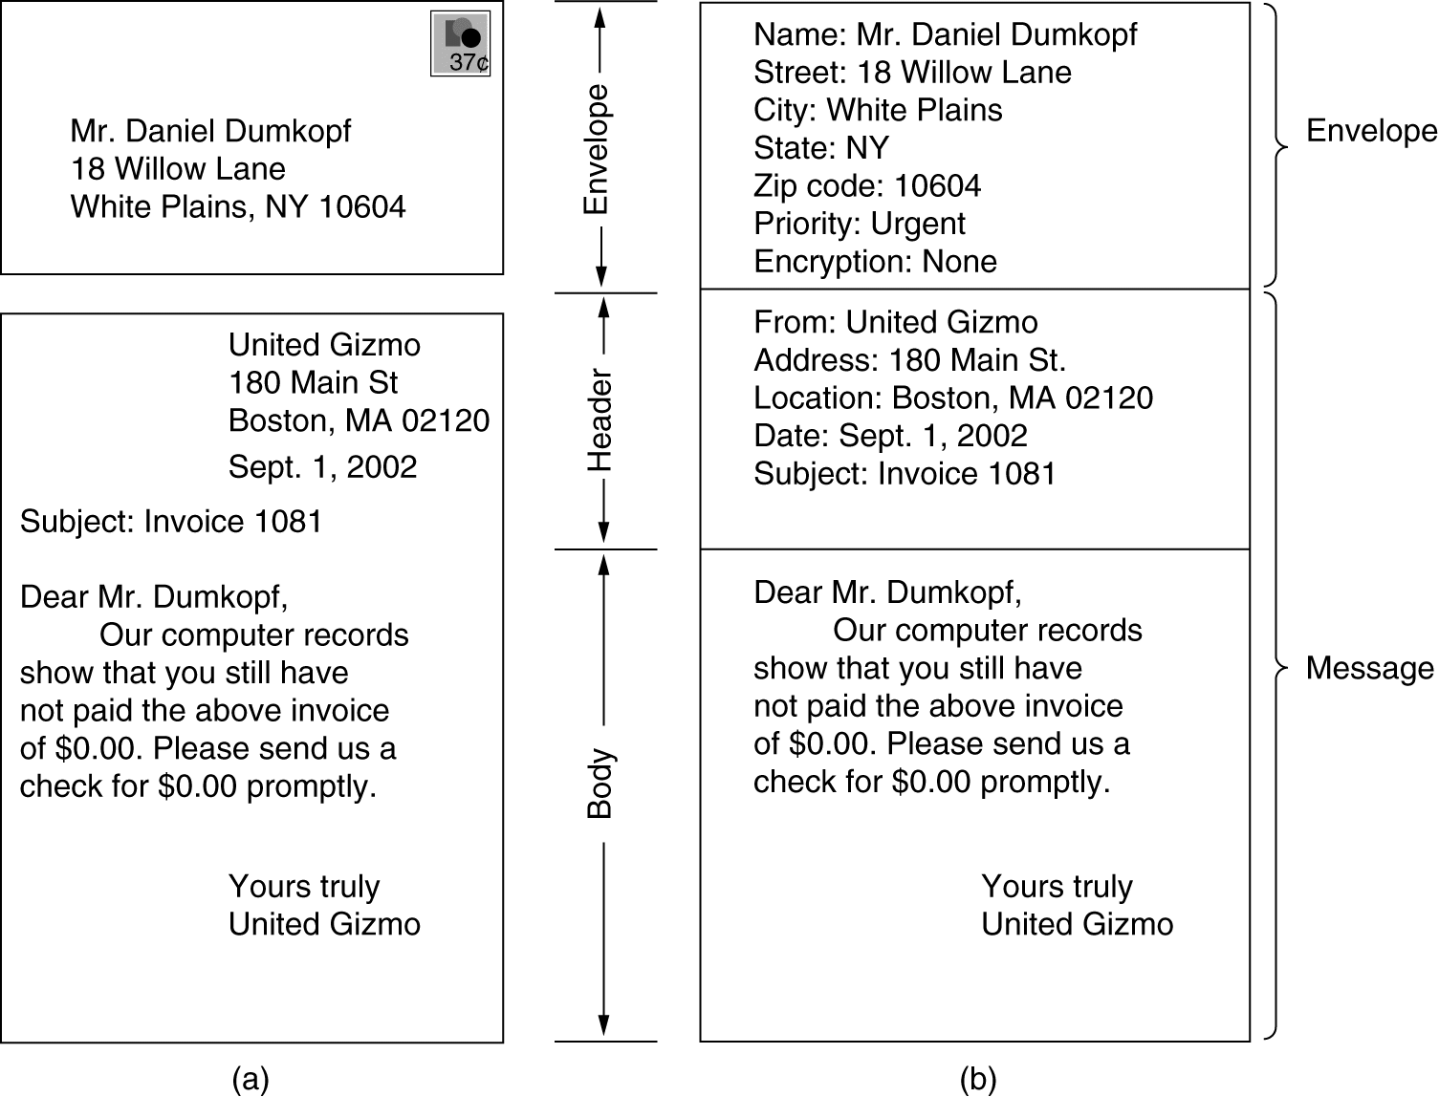
Email Message Structure
Envelopes and messages. (a) Paper mail. (b) Electronic mail.

Slide 68
Email Systems
Has two basic parts:
  User agent: a program that accepts a variety of commands for composing, receiving, and replying to messages, as well as for manipulating mailboxes
  Message transfer agents: relaying messages from the originator to the recipient

Slide 69
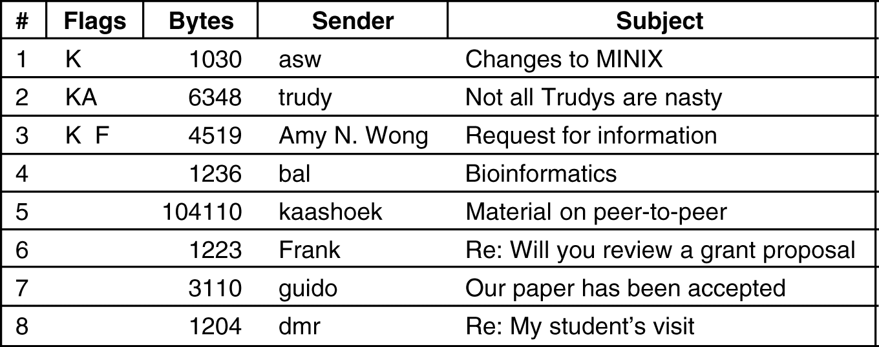
Reading E-mail
Address format: user@dns-address
An example display of the contents of a mailbox.

Slide 70
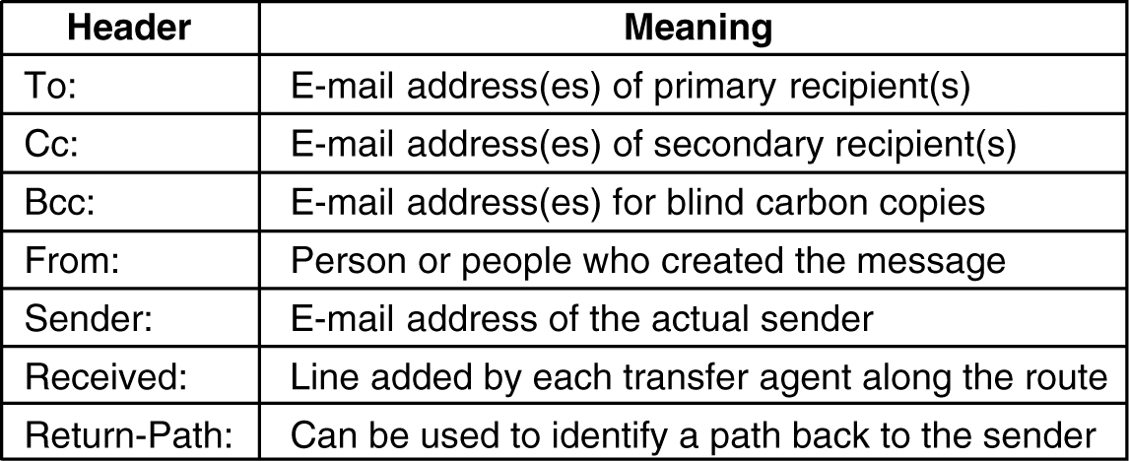
Message Formats
RFC 822 header fields related to message transport.

Slide 71
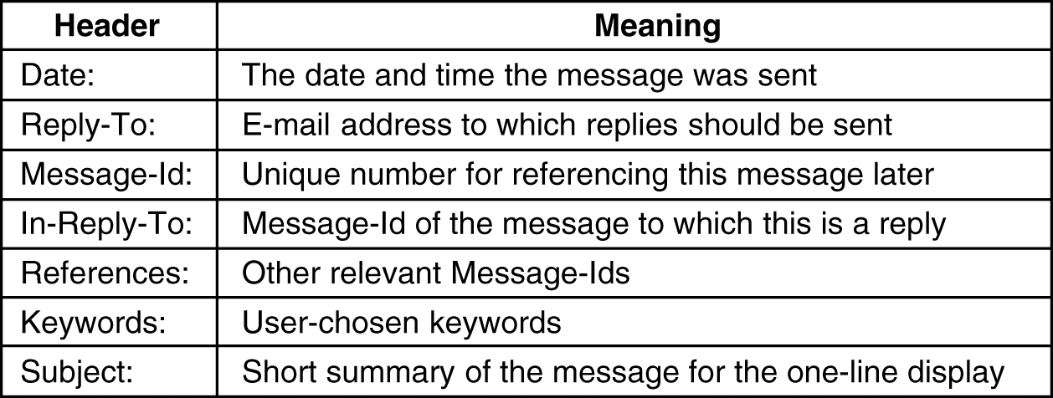
Message Formats (2)
Some fields used in the RFC 822 message header.

Slide 72
MIME – Multipurpose Internet Mail Extensions
Some problems when using ASCII formatted messages:
  Languages with accents
  (French, German).
  Languages in non-Latin alphabets
  (Hebrew, Russian).
  Languages without alphabets
  (Chinese, Japanese).
  Messages not containing text at all
  (audio or images).
MINE adds structure to the message body and defines encoding rules for non-ASCII messages

Slide 73
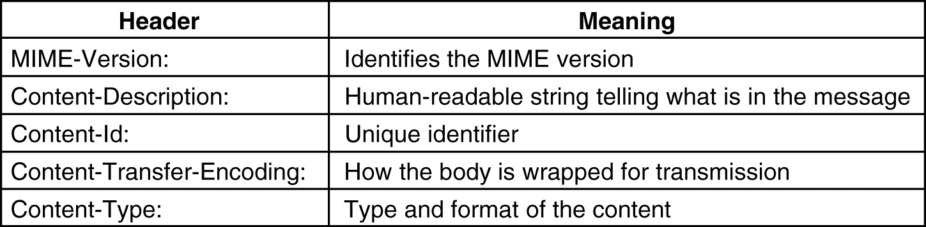
MIME (2)
RFC 822 headers added by MIME.

Slide 74
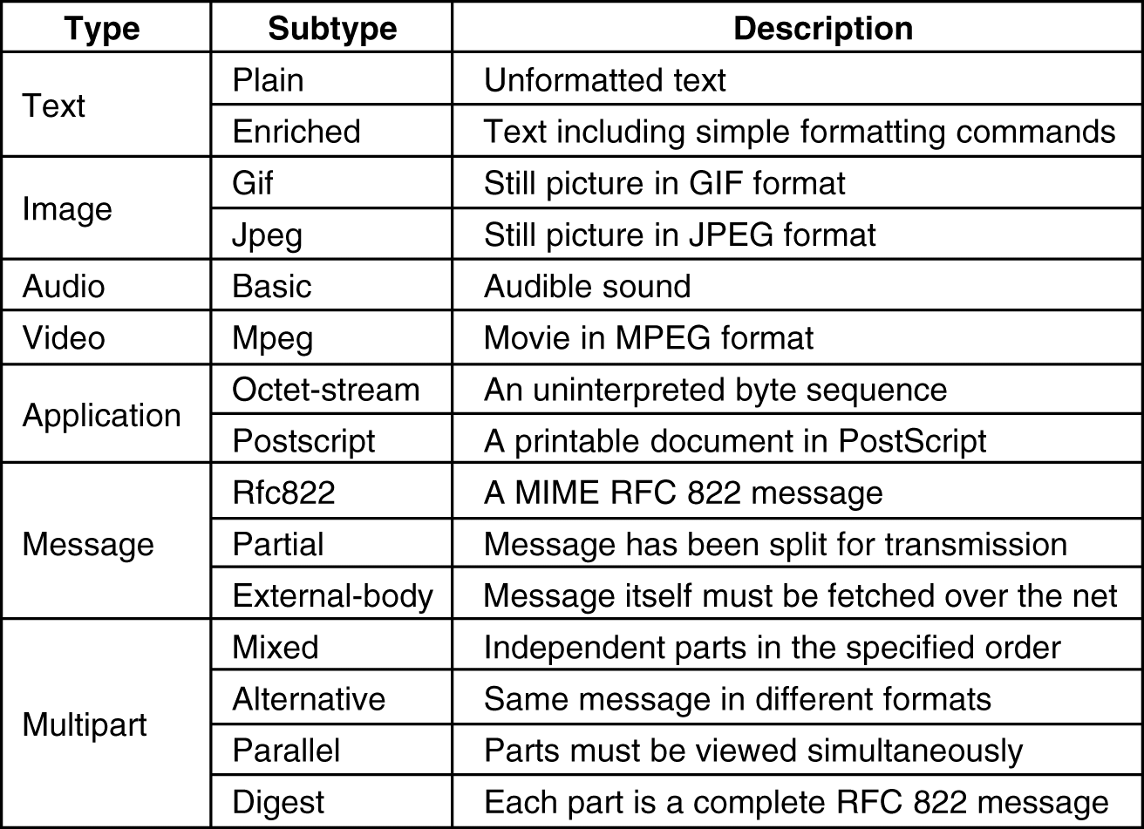
MIME (3)
The MIME types and subtypes defined in RFC 2045.

Slide 75
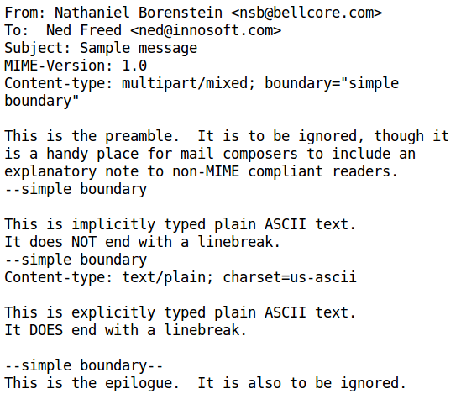
multipart/mixed

Slide 76
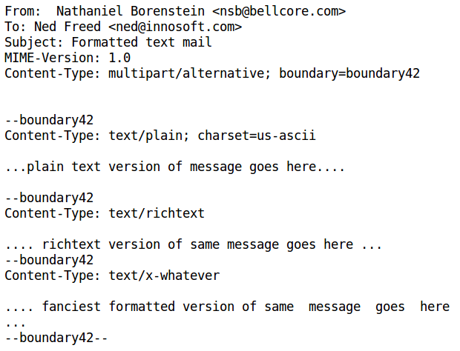
multipart/alternative

Slide 77
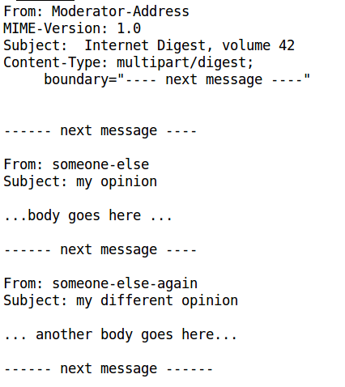
multipart/digest

Slide 78
Message Transfer
Message transfer agents are daemons running on mail servers
Use Simple Mail Transfer Protocol
Use TCP on port 25

Slide 79
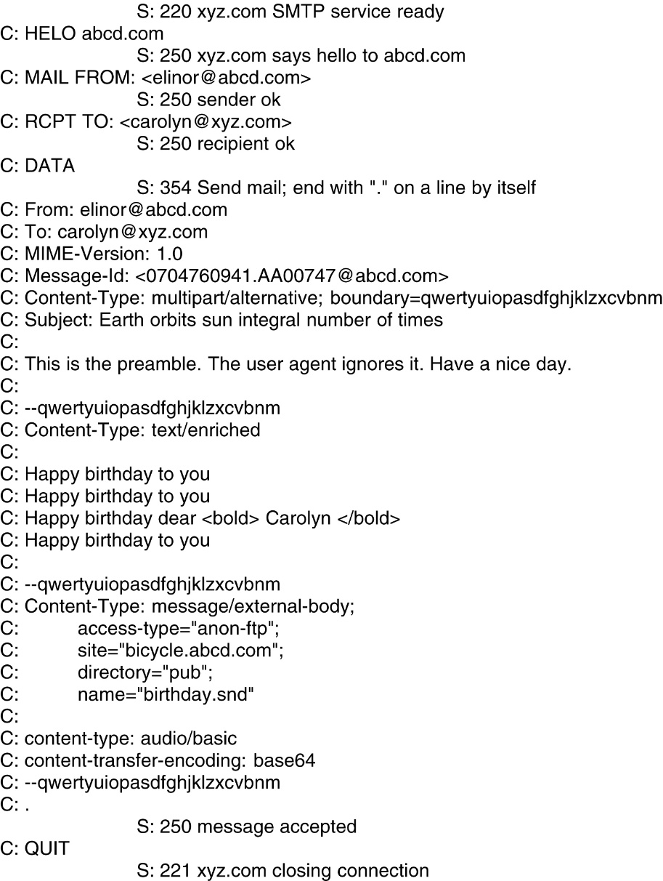
Message Transfer (2)
Transferring a message from elinore@abc.com to carolyn@xyz.com
Using SMTP.

Slide 80
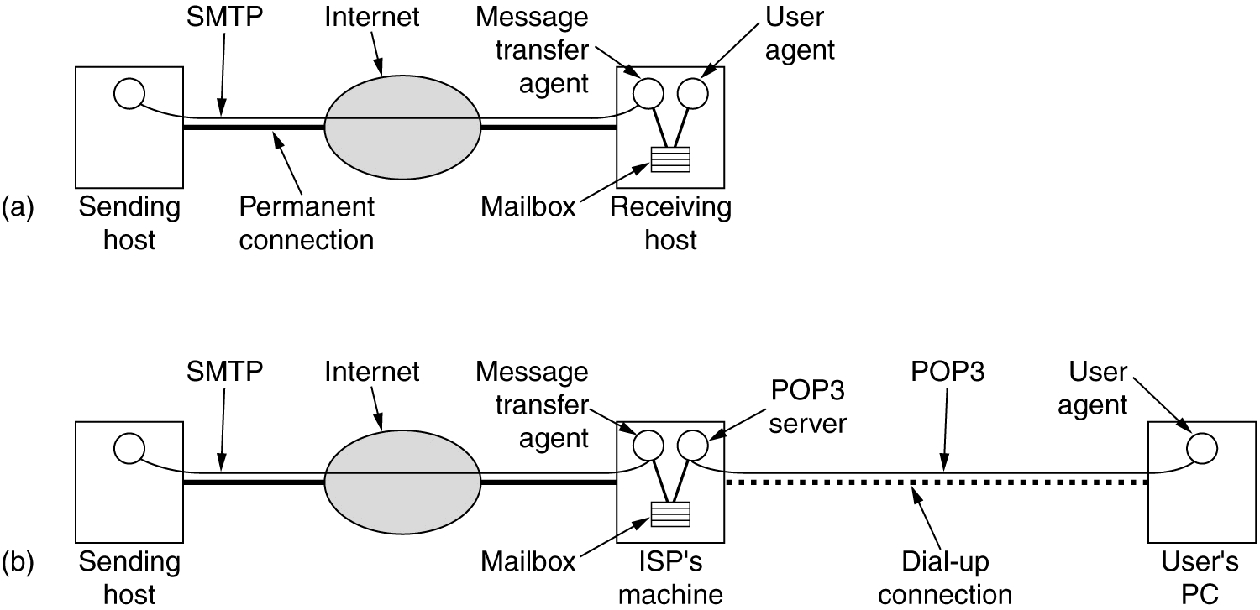
Final Delivery
(a) Sending and reading mail when the receiver has a permanent Internet connection and the user agent runs on the same machine as the message transfer agent. (b) Reading e-mail when the receiver has a dial-up connection to an ISP.

Slide 81
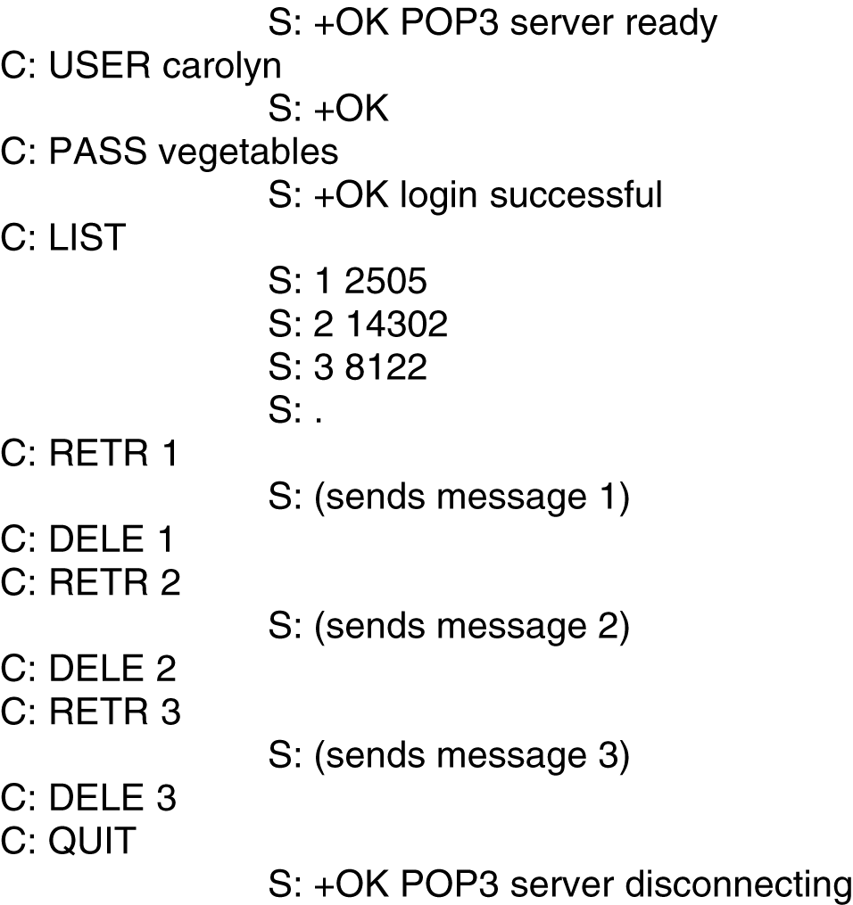
POP3
Post Office Protocol Version 3
Use TCP on port 110
Is used to download messages from a mail server to client computers
Example: Using POP3 to fetch three messages.

Slide 82
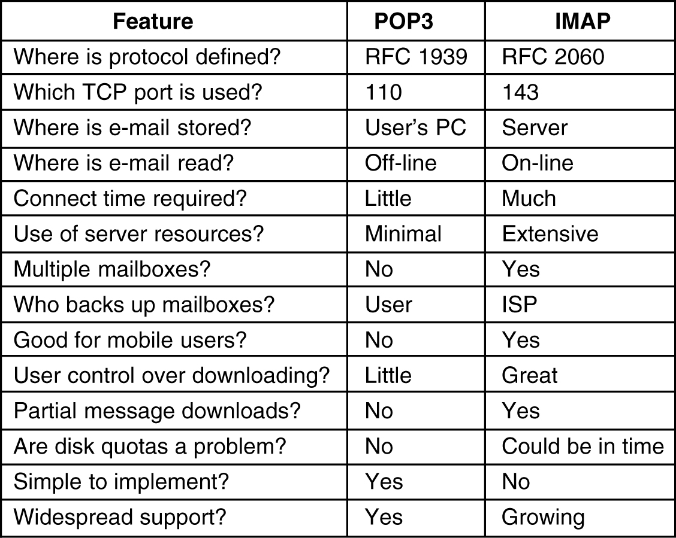
IMAP (Internet Message Access Protocol)
POP3 is not convenient when users frequently use different machines to read email from servers, as emails have to be downloaded to different computers more or less random
IMAP can resolve this issues as emails will be always on the servers
A comparison of POP3 and IMAP.

Slide 83


Web Mail
HTTP
SMTP
HTTP
user
agent
ordinary
Web browser
user
agent
ordinary
Web browser
sender’s mail
server
receiver’s mail
server
Convenient for the user on the go (Internet Café, WebTV, …)
User can organize their hierarchy of folders on servers
May be slow:
  server typically far from client
  interaction with server through CGI scripts

Slide 84
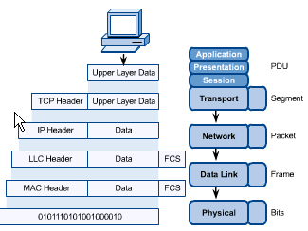
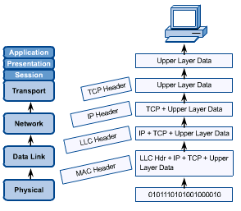
OSI in Action
OSI Model
A message begins at the top application layer and moves down the OSI layers to the bottom physical layer.
As the message descends, each successive OSI model layer adds a header to it.
A header is layer-specific information that basically explains what functions the layer carried out.
Conversely, at the receiving end, headers are striped from the message as it travels up the corresponding layers.

Slide 85
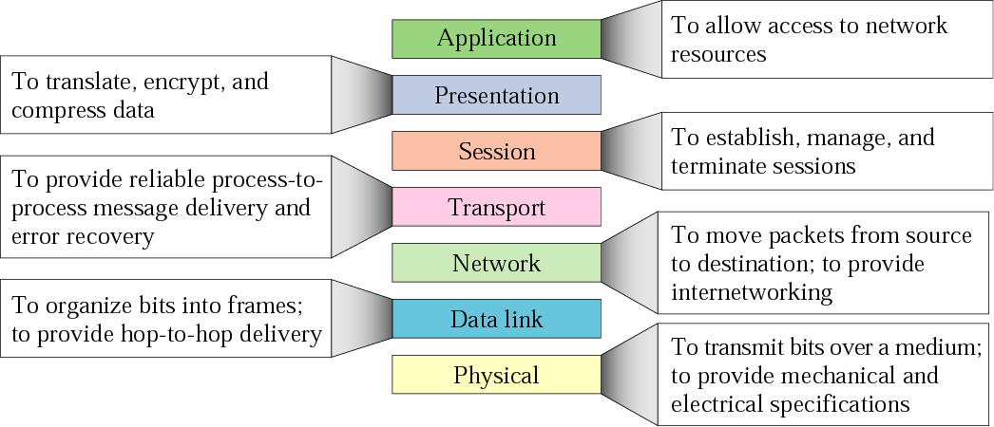
Figure 2.14 Summary of layers

Slide 86
2.3 TCP/IP Protocol Suite
The TCP/IP protocol suite is made of five layers: physical, data link, network, transport, and application. The first four layers provide physical standards, network interface, internetworking, and transport functions that correspond to the first four layers of the OSI model. The three topmost layers in the OSI model, however, are represented in TCP/IP by a single layer called the application layer.
The topics discussed in this section include:
Physical and Data Link Layers
Network Layer
Transport Layer
Application Layer

Slide 87
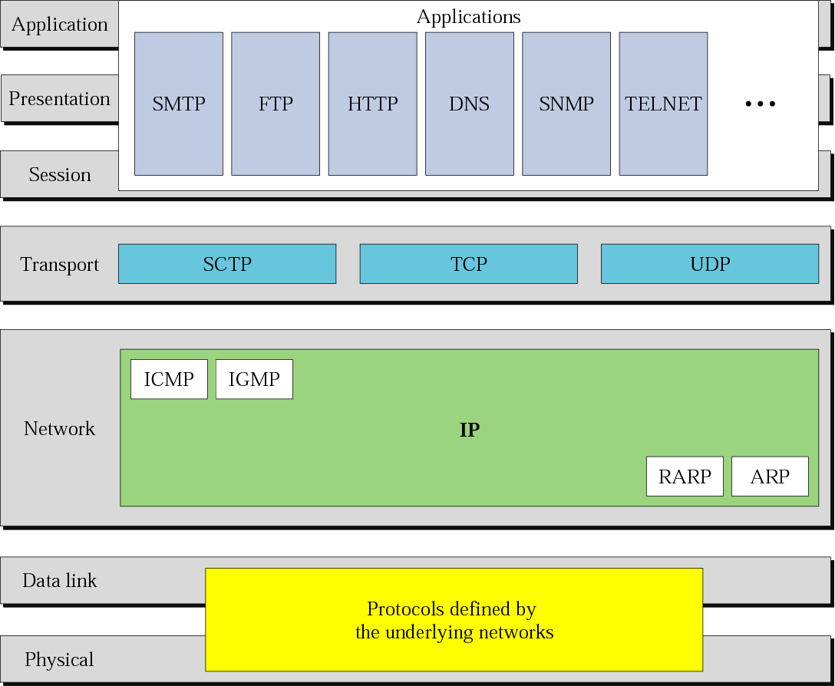
Figure 2.15 TCP/IP and OSI model

